Slide 1
Design Week 3 User Interface Design
Focus on the user Interface
Last week
  Design Patterns
  Design Principles
These were for designing the modules/programs of the system.
Do not confuse design patterns from last week with GUI patterns this week.
Last week maps to section D of the slide show (stand alone presentation)
This week maps to section B.
Make Sure you are in the right group. Email me if not.

Slide 2
Human Computer Interaction (HCI) &User Interface Design(UID)
Key Definitions
The User Interface define how the system will interact with external entities
The System Interfaces define how systems exchange information with other systems

Slide 3
Many people believe that improving interaction is one of the most important activities in system design

Slide 4
Mental model: the way a user sees a problem
Interface which closely match the user view or mental model are easier to user

Slide 5
Cognitive Gap
Gap between the user mental view and what is presented on the screen is usually called a cognitive gap.
The gap defines the amount of thinking that must take place for a user to make sense of what they see on the screen.
Designers must provide a metaphor that will help users solve their problems in terms of objects that they can readily understand in terms of their everyday work
Q. What is a metaphor? Can you give an example?

Slide 6
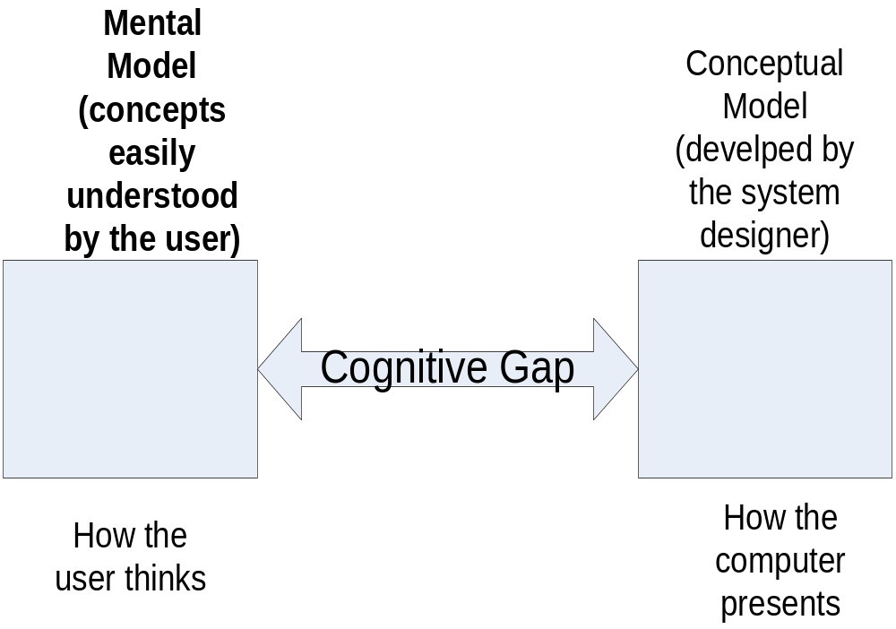

Slide 7
Interface Principles
The same screen must support a number of different users
User friendly: means that the interface should be helpful, tolerant, and adaptable and the user should be happy and confident to use it.
Robustness: interface should not fail because of some action taken by the user

Slide 8
Separable User Interfaces
The user interface should be independent of the functional aspects of the system that the user interface serves.
User Interface Management Systems (UIMS)
  So important that development tools to automate the implementation of user interfaces from abstract specifications are built
<number>/30

Slide 9
Key Definitions
Three mechanisms to consider for an Interface:
The navigation mechanism provides the way for users to tell the system what to do
The input mechanism defines the way the system captures information
The output mechanism defines the way the system provides information to users or other systems

Slide 10
Human Machine Interface(HMI)
System users often judge a system by its
interface rather than its functionality
A poorly designed interface can cause a user to make catastrophic errors
Poor user interface design and not necessarily functionality is the reason why so many software systems are never used.
E.g. text editors

Slide 11
Graphical User Interface
Most popular
They are easy to learn and use.
The user may switch quickly from one task to another and can interact with several different applications.
Fast, full-screen interaction is possible with immediate access to anywhere on the screen

Slide 12
HCI design patterns
An approach to reusing knowledge about successful design solutions in HCI.
problem within a specific context.
Examples:
Light on Two Sides of Every Room (architecture)
Go back to a safe place (HCI)

Slide 13
Guidelines and Patterns
Guidelines: Specific rules that capture design and knowledge e.g.
    Use blue colour for Text links
    Use dark text on light background
    Avoid Technical terms (Jargon)
    Limit use of images / animations
Design patterns: Proven solutions to a design problem e.g.
    Tab navigation
    Breadcrumbs
    Printer friendly page
    Site Map
    Action Button
    Date Selector
Notes:
How can we help designers to design better products.
Tools that can be effective and useful to designers should be based not only on theory but on proven knowledge and experience
Guidelines and patterns are two tools that are based on knowledge and experience and can hep designers design more usable web sites.
Between the two of them Patterns is a more recent approach

Slide 14
Title: Printer-friendly Page
Van Welie Pattern Language
(www.welie.com)
Background- Context
  Printing web pages is often problematic
  Parts of the page may not be printed or formatted wrongly.
Problem Statement
  Users need to print the content of a page
and Forces
  You don't want to print all the surrounding page elements.
  Print-ready version is often preferred since there aren’t any disturbing elements
  Many users know that printing web pages can be problematic, and the 'printer-friendly' version is now a common practise
  The link must preferably be placed at the top
Notes:
The context specifies when the pattern is used
The problem here is Users need to print the content of the page
The forces section clarify the problem more
Present the advantages and the drawbacks
You don't want to print all the surrounding page elements the navigation bars or all the images
The format of a web page is suitable for viewing on the screen not for printing.
Printing web pages is often Problematic because the pages are not designed to be printed. Consequently, parts of the page may not be printed or formatted wrongly. On sites that have a content that is likely to involve a significant amount of reading, special arrangements need to be made so that the printed page looks good.
Problem
Forces
If you print an article, you don't want to print all the surrounding page elements. In addition, when reading an article the print-ready version is often preferred by many since it doesn't have any disturbing elements such as navigation or advertisements. Many users know that printing web pages is Problematic and the 'printer-friendly' version is now a common good that is learnt by users. Some people with disabilities using assistive technology also benefit from a 'printer-friendly' page. The link must preferably be placed at the top of the of the page so that users can see it immediately. That way they don't have to scroll down and notice it there.

Slide 15
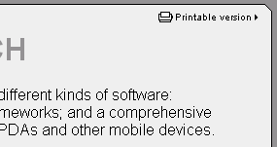
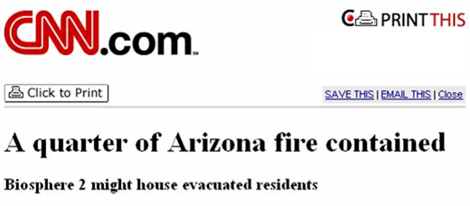
Printer-friendly Page (cont.)
Solution
    Place a link to a printer-friendly version of the page the users are viewing next to the page content
Examples
Pattern
Notes:
And here are some examples of this pattern

Slide 16


Examples
Van Welie Pattern Language
(www.welie.com)
Breadcrumbs
Tab Navigation
Notes:
Other examples of Patterns that I am sure you are familiar with
Problem: The users need to know where they are in a hierarchical structure
Show the path from the top level to the current page.
Context
Sites with a large hierarchical information structure, typically more than 3 levels deep. Such sites are medium to large sized and include shops, catalogs, portals, corporate sites etc. The site has got a main navigation scheme that allows users to traverse the hierarchy. Users may want to jump several steps back instead of following the hierarchy. Users may be unfamiliar with the hierarchical structure of the information. Users may need to know where they can go. users need to know how they arrived at their current location.
Solution
Why
The bread crumbs show the users where they are and how the information is structured. Because users see the way the hierarchy is structured they can learn it more easily. By making each label a link, the users can quickly browse up the hierarchy. They take up minimal space on the page and leave most of the space for the real content.
Navigation
Use a double tabular bar to show the 2 top levels of the web site

Slide 17
Guidelines
  Recommended courses of action in support of a set of principles and specific to a particular domain such as the Web
  Examples
    Use blue colour for Text links
    Use dark text on light background
    Avoid Technical terms (Jargon)
    Limit visitor scrolling
    Limit use of images / animations
Notes:
Guidelines are a more traditional format for capturing knowledge and experience and presenting advice about design
Guidelines come in a smaller format mostly consisting of just 1 sentence
like these examples here
Guidelines may be based on
design principles about Human-computer Interaction and interface design,
on cognitive psychology
and of course on practical experience.
Also on
Hypothesis testing
Non-hypothesis-oriented experiment
Surveys
Expert opinion
Provide guidance regarding
Navigation structure
Site Design / Page Design:
Titles / Headings
Page Length
Font Styles and Sizes
Links
Colors
Graphics / Animations
Consistency

Slide 18
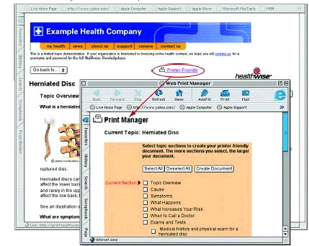
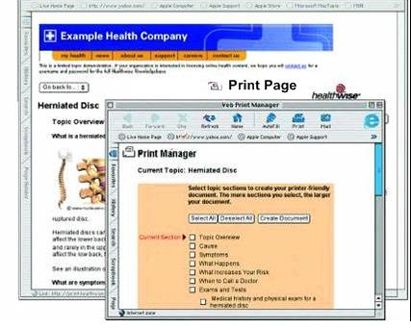
Guideline: Provide Printing Options
  (Koyani et al. 2003)
  Provide a link to a complete printable or downloadable document
  if there are Web pages, documents, resources, or files that users will want to print or save in one operation.
Guideline
Notes:
This is an example of a guideline.
We picked up an example that is the same as the pattern example presented earlier on
This relation of 1: 1 exists because the pattern is a low level pattern and can be formulated as a single guideline.
Usually high level or abstract patterns correspond to more than 1 guideline.

Slide 19
Usability Heuristics/Guidelines
Jakob Nielsen :
http://www.useit.com/papers/heuristic/heuristic_list.html
Examples:
http://designingwebinterfaces.com/6-tips-for-a-great-flex-ux-part-5
<number>/30

Slide 20
Ten Usability Heuristics/Guidelines
(Nielsen)
Visibility of system status The system should always keep users informed about what is going on, through appropriate feedback within reasonable time.
Match between system and the real world The system should speak the users' language, with words, phrases and concepts familiar to the user, rather than system-oriented terms. Follow real-world conventions, making information appear in a natural and logical order.
User control and freedom Users often choose system functions by mistake and will need a clearly marked "emergency exit" to leave the unwanted state without having to go through an extended dialogue. Support undo and redo.
Consistency and standards Users should not have to wonder whether different words, situations, or actions mean the same thing. Follow platform conventions.

Slide 21
Error prevention Even better than good error messages is a careful design which prevents a problem from occurring in the first place. Either eliminate error-prone conditions or check for them and present users with a confirmation option before they commit to the action.
Recognition rather than recall Minimize the user's memory load by making objects, actions, and options visible. The user should not have to remember information from one part of the dialogue to another. Instructions for use of the system should be visible or easily retrievable whenever appropriate.
Flexibility and efficiency of use Accelerators -- unseen by the novice user -- may often speed up the interaction for the expert user such that the system can cater to both inexperienced and experienced users. Allow users to tailor frequent actions.

Slide 22
Aesthetic and minimalist design Dialogues should not contain information which is irrelevant or rarely needed. Every extra unit of information in a dialogue competes with the relevant units of information and diminishes their relative visibility.
Help users recognize, diagnose, and recover from errors Error messages should be expressed in plain language (no codes), precisely indicate the problem, and constructively suggest a solution.
Help and documentation Even though it is better if the system can be used without documentation, it may be necessary to provide help and documentation. Any such information should be easy to search, focused on the user's task, list concrete steps to be carried out, and not be too large

Slide 23
Advantages of using HCI Patterns
Present a solution by demonstrating how conflicting forces in a design can be resolved (Mahemoff & Johnston 2001).
Provide much richer information than guidelines (Pemberton & Griffiths 2003)
Draw the attention to the problem that is solved in the context of the design (Pemberton & Griffiths 2003)
Patterns are “engaging and lively in a way that guidelines are not” (Pemberton & Griffiths 2003)
Patterns Support Creativity (van Duyne et al.)
Notes:
Several authors have argued about the advantages of patterns. These advantages are highlighted by comparing patterns to guidelines
The advantages are:
SLIDES
However, there is little empirical evidence and evaluation about the advantages
Patterns come from successful examples
Also A design can be generated by following the links between patterns (Alexander 1977)
Patterns let designers focus on the hard, unique problems to their design situation
every real design will have many of these
sites that are so successful that lots of users are familiar with their paradigms (e.g., Yahoo)
interaction techniques/metaphors that work well across many sites (e.g., shopping carts)
Not too general & not too specific
designer needs to specialize to their needs
This finishes our review about patterns. We shall continue by looking at guidelines.
Patterns
Using Patterns
Patterns
Patterns

Slide 24
Limitations of guidelines
Guidelines are often too simplistic or too abstract
Guidelines can be difficult to select and difficult to interpret
Guidelines can conflict with each other
  “Use longer pages to ease page maintenance”
  “Use shorter pages to make site more maintainable”
Notes:
Although guidelines can be useful in guiding the designer to take the right decision and prevent errors in interface design, several authors have argued about their limitations and drawbacks. These drawbacks some times are highlighted by comparing guidelines to patterns.
There are some limitations and shortcomings regarding the use:
SLIDES
Contained conflicting guidance
“Use longer pages to ease page maintenance”
“Use shorter pages to make site more maintainable”
Guidelines have authority issues concerning their validity
Guidance too general, and not be specific
Despite their shortcomings guidelines remain the most widely accepted form of presenting experience and knowledge. Furthermore, the durability and endurance of guidelines is remarkable. Nielsen (2005) reports that general guidelines built 20 years ago are still up to 70% valid and applicable, while 78% of guidelines from the early days of the web continue to be valid and relevant

Slide 25
Patterns and Guidelines
Both formats capture knowledge and help designers reusing that knowledge.
However
Guidelines focus mostly on small detailed issues of interface design while patterns provide more generic design guidance

Slide 26
Guidelines
Guidelines remain the most widely accepted form of presenting experience and knowledge.
78% of guidelines from the early days of the web continue to be valid and relevant
Notes:
Furthermore, the durability and endurance of guidelines is remarkable.

Slide 27
Further Reading
More on HCI patterns: http://www.hcipatterns.org/
(IFIP group), http://designinginterfaces.com
See also tutorial links

Slide 28
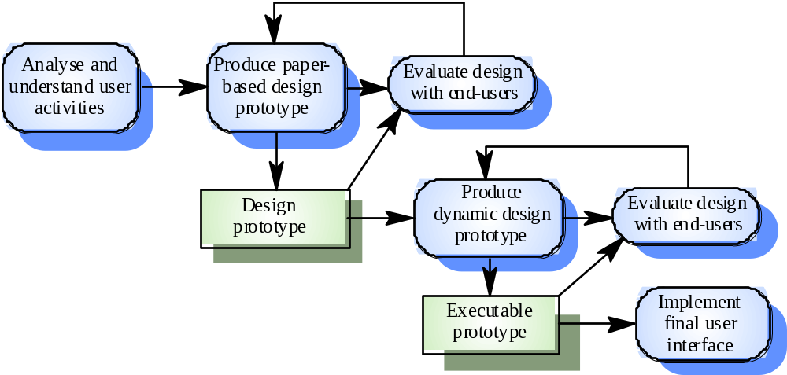
User interface design process (Sommerville)

Slide 29
Interface Structure Diagram
Shows how all screens, forms, and reports are related
Shows how user moves from one to another
Similar to DFD in using boxes and lines
Different from DFD in having no standard rules or formats
Boxes denote screens
Lines show movement from one to another

Slide 30
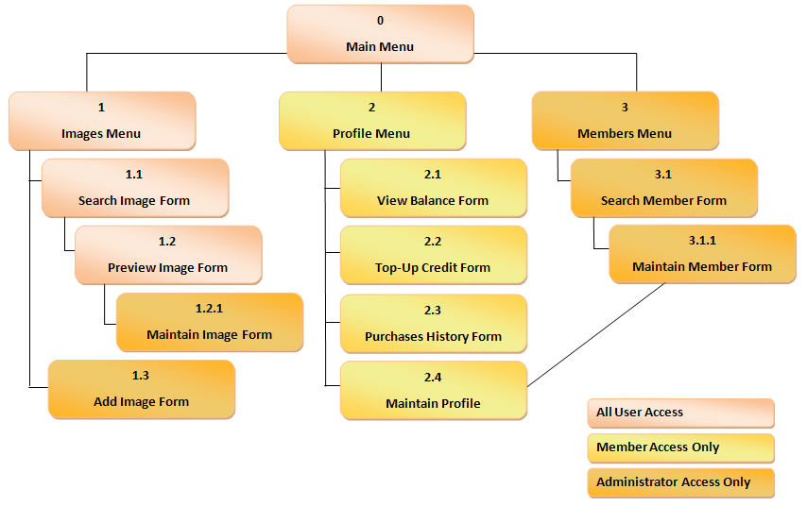
Interface Structure Diagram Example

